Slide 1
Chapter 5
Selection—Making Decisions
Objectives
❏ To understand how decisions are made in a computer
❏ To understand the logical operators: and, or, and not A+L+U
❏ To understand how a C program evaluates a logical expression
❏ To write programs using logical and comparative operators
❏ To write programs that use two-way selection: if ... else statements
❏ To write programs that use multi-way selection: switch and else ...if
❏ To understand C’s classification of characters
❏ To write programs that use C’s character functions
❏ To be able to design a structure chart that specifies function selection

Slide 2
5-1 Logical Data and Operators
A piece of data is called logical if it conveys the idea of true or false. In real life, logical data (true or false) are created in answer to a question that needs a yes–no answer. In computer science, we do not use yes or no, we use true or false.
Topics discussed in this section:
Logical Data in C
Logical Operators
Evaluating Logical Expressions
Comparative Operators

Slide 3
FIGURE 5-1 true and false on the Arithmetic Scale

Slide 4
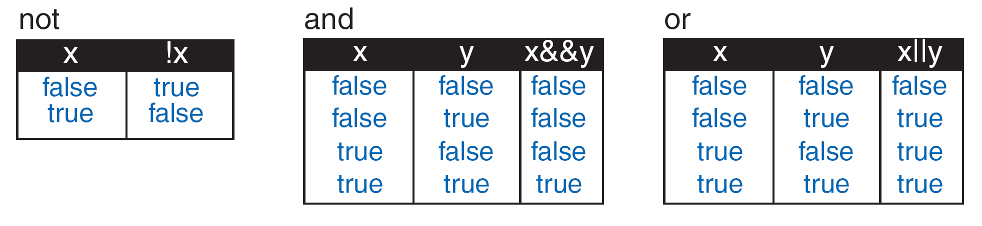
!
FIGURE 5-2 Logical Operators Truth Table

Slide 5
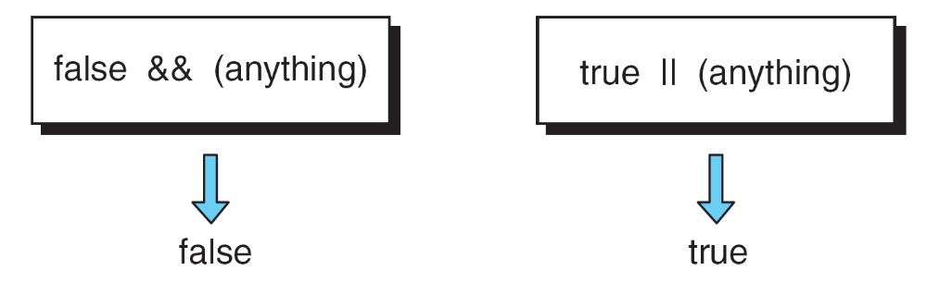
FIGURE 5-3 Short-circuit Methods for and /or

Slide 6
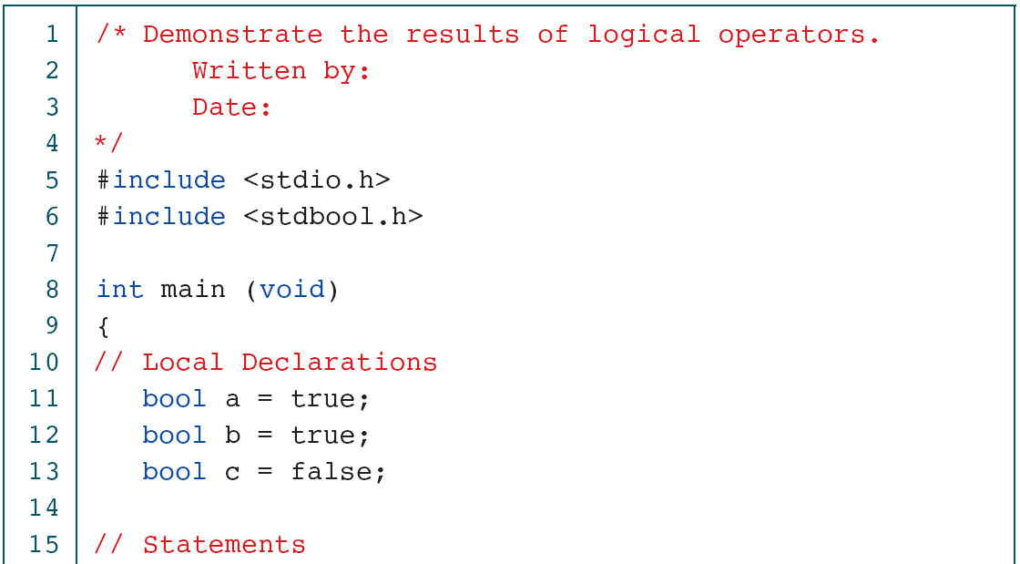
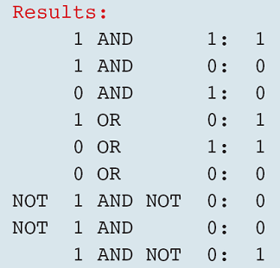
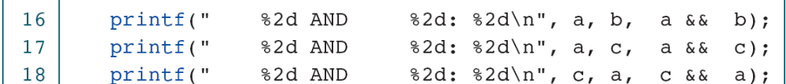
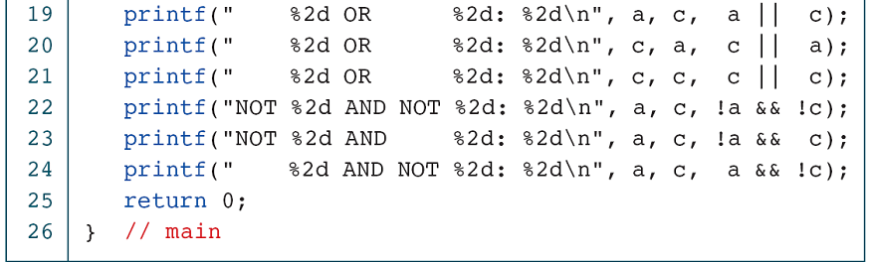
PROGRAM 5-1
Logical Expressions

Slide 7
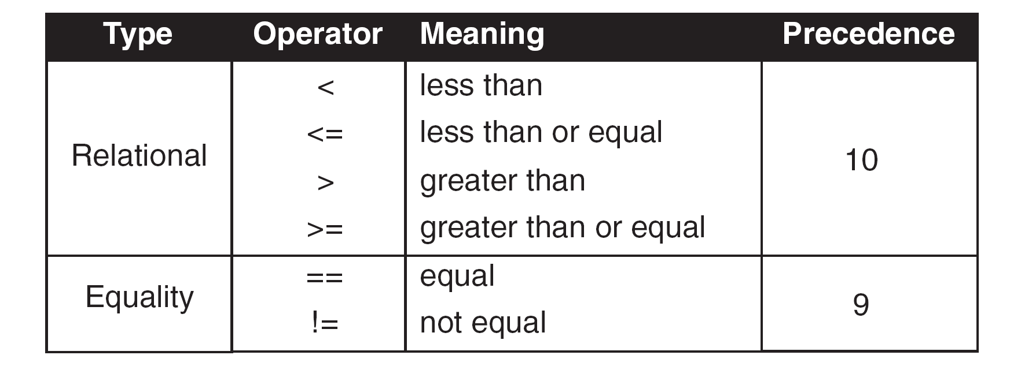
FIGURE 5-4 Relational Operators

Slide 8
FIGURE 5-5 Comparative Operator Complements

Slide 9
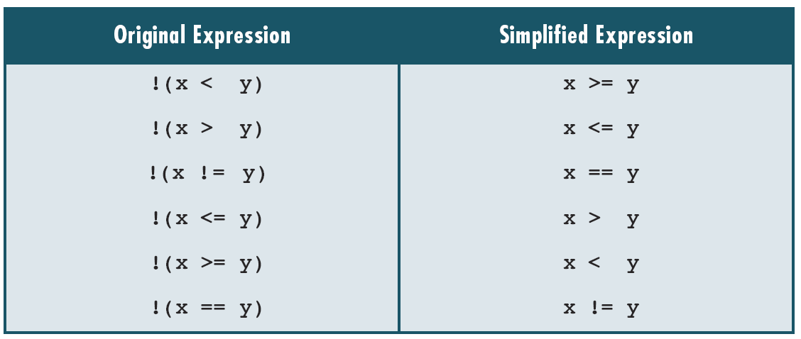
Table 5-1
Examples of Simplifying Operator Complements

Slide 10
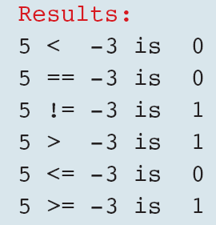
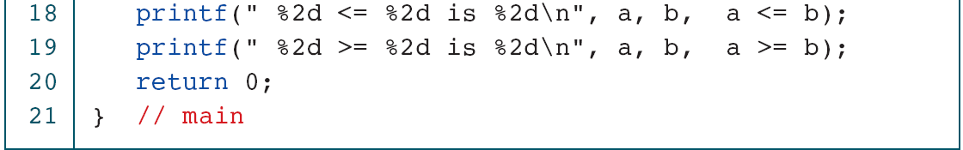
PROGRAM 5-2
Comparative Operators

Slide 11
5-2 Two-Way Selection
The decision is described to the computer as a conditional statement that can be answered either true or false. If the answer is true, one or more action statements are executed. If the answer is false, then a different action or set of actions is executed.
Topics discussed in this section:
if…else and Null else Statement
Nested if Statements and Dangling else Problem
Simplifying if Statements
Conditional Expressions

Slide 12
FIGURE 5-7 if...else Logic Flow

Slide 13
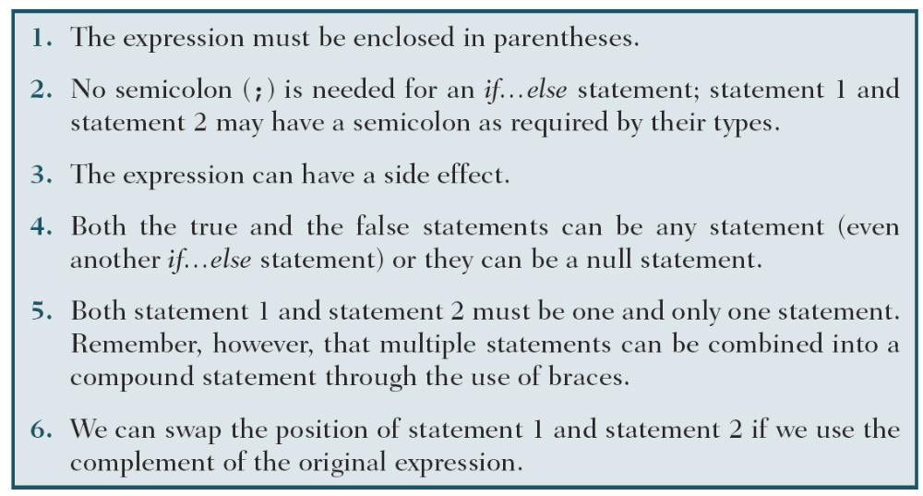
Table 5-2
Syntactical Rules for if…else Statements

Slide 14
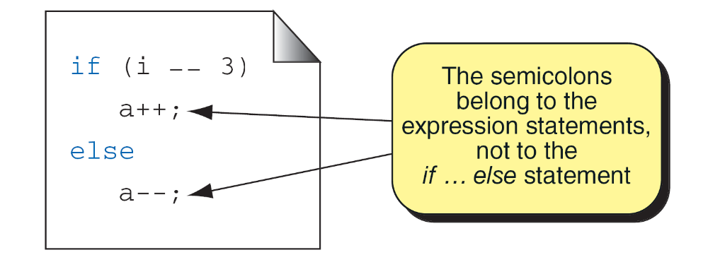
FIGURE 5-8 A Simple if...else Statement

Slide 15
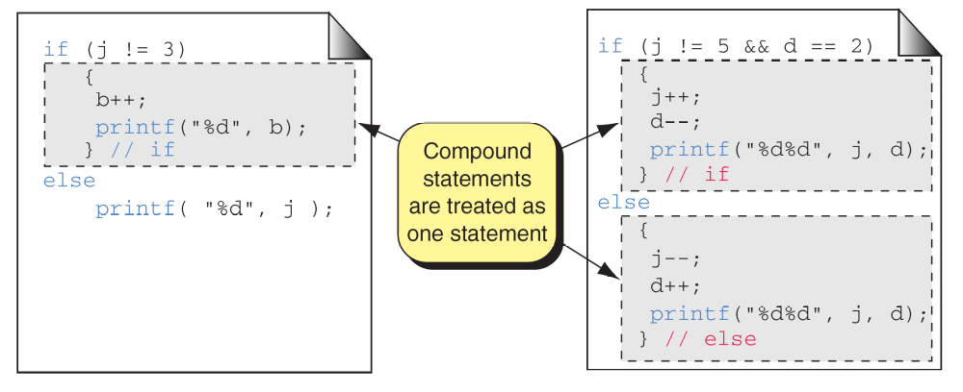
FIGURE 5-9 Compound Statements in an if...else

Slide 16
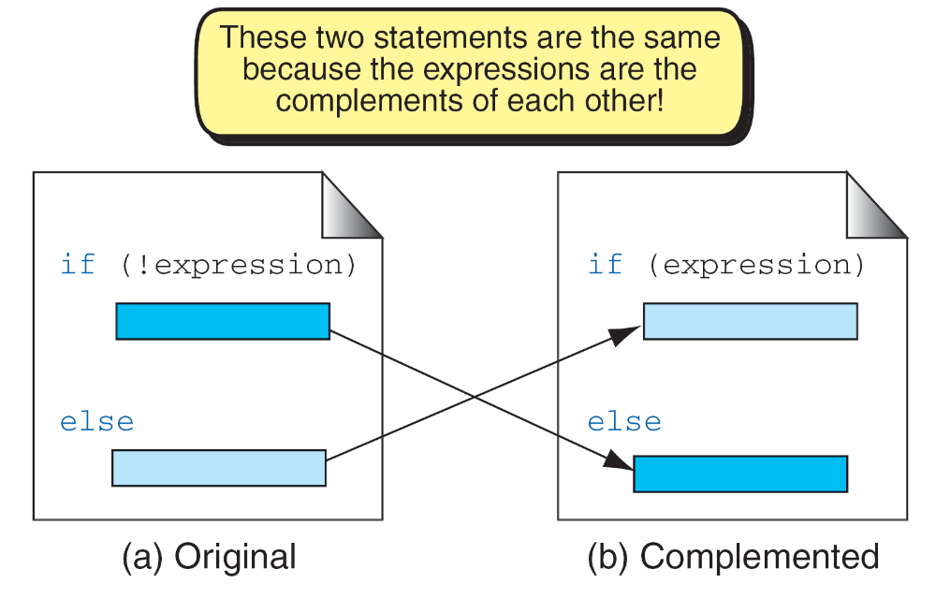
FIGURE 5-10 Complemented if...else Statements

Slide 17
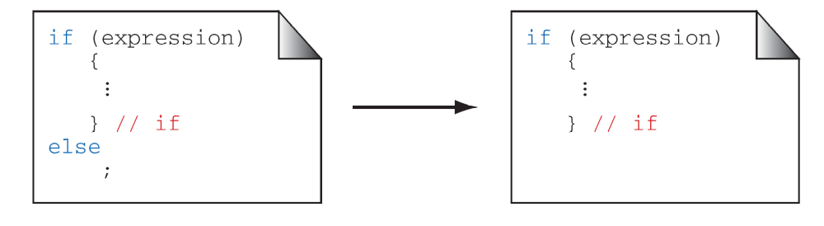
FIGURE 5-11 A Null else Statement

Slide 18
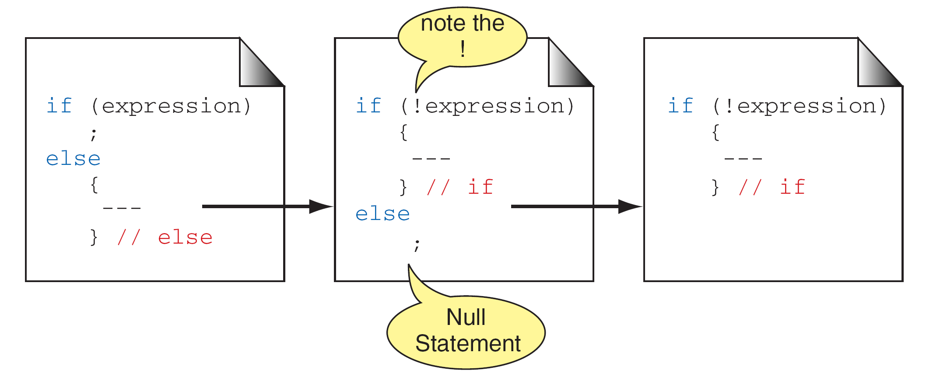
FIGURE 5-12 A Null if Statement

Slide 19
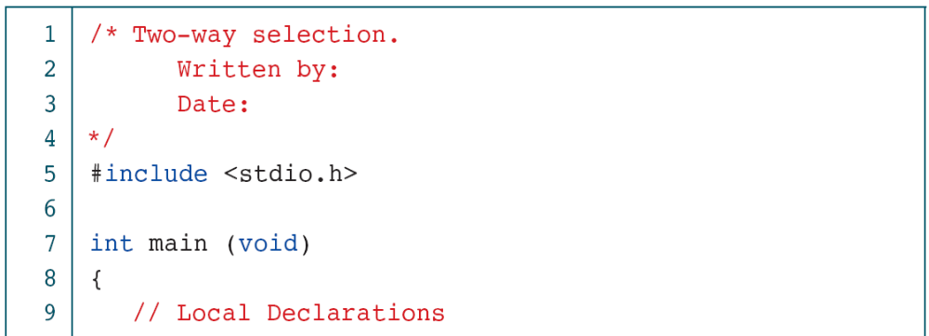

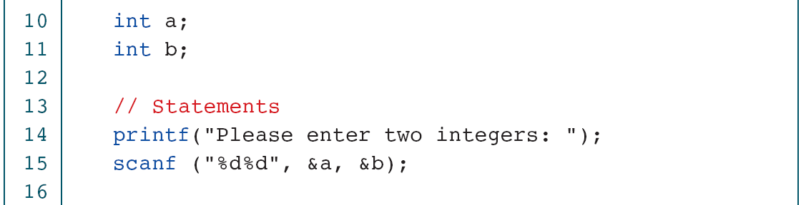
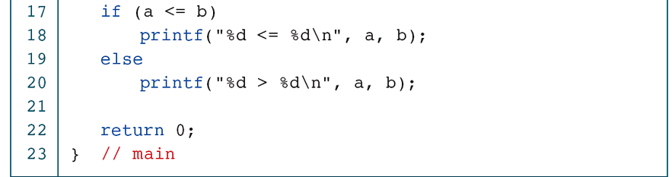
PROGRAM 5-3
Two-way Selection

Slide 20
FIGURE 5-13 Nested if Statements

Slide 21
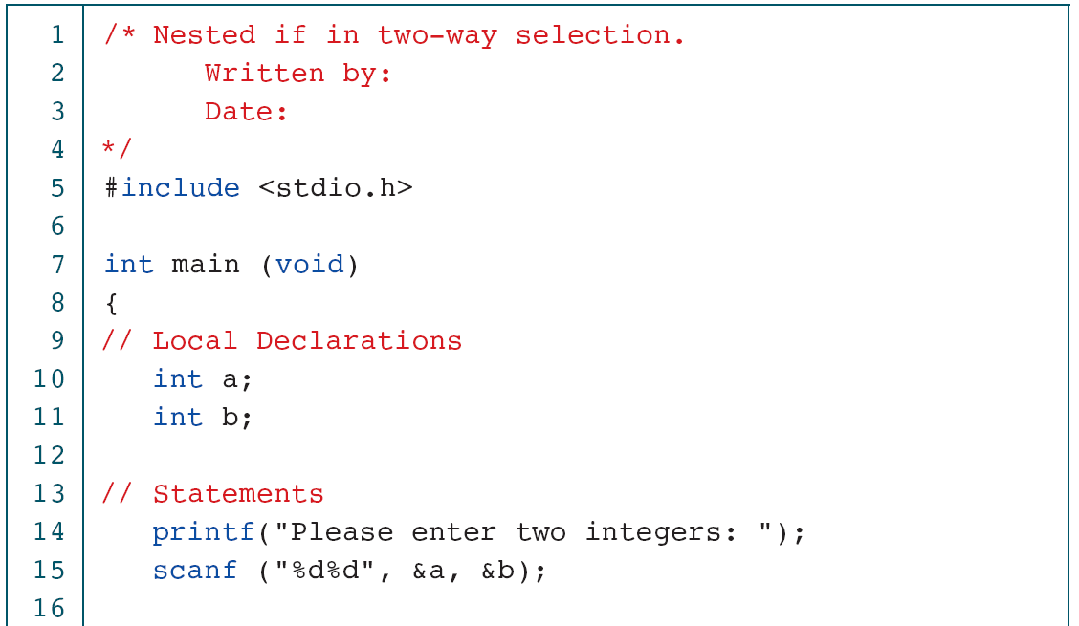

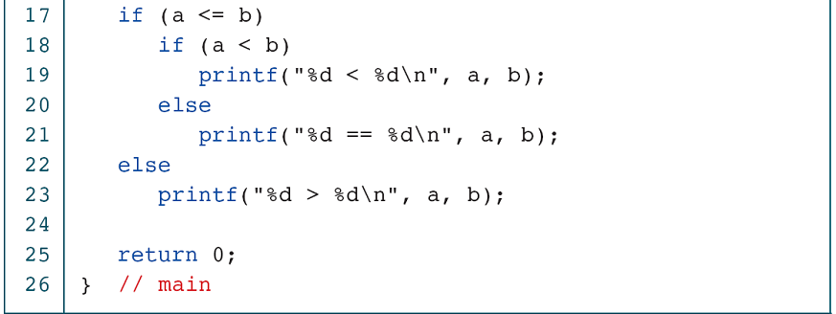
PROGRAM 5-4
Nested if Statements

Slide 22
Note
else is always paired with the most recent unpaired if.
FIGURE 5-14 Dangling else

Slide 23
FIGURE 5-15 Dangling else Solution

Slide 24
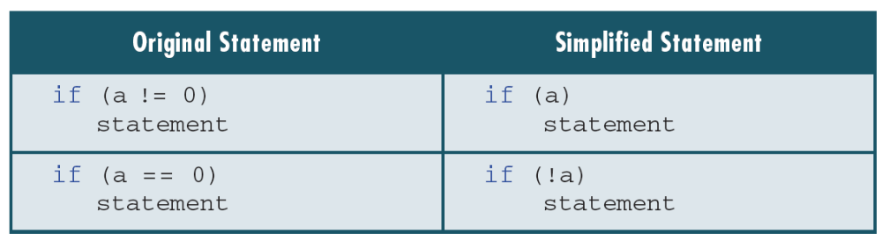
Table 5-3
Simplifying the Condition

Slide 25
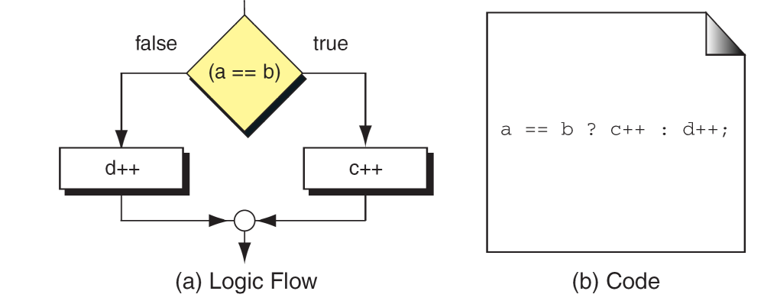
FIGURE 5-16 Conditional Expression

Slide 26
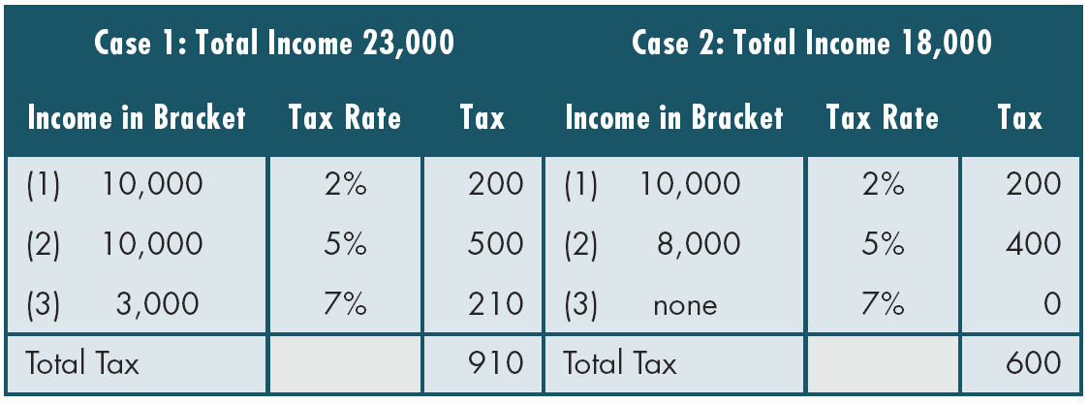
Table 5-4
Examples of Marginal Tax Rates

Slide 27
FIGURE 5-17 Design for Calculate Taxes

Slide 28
FIGURE 5-18 Design for Program 5-5 (Part I)

Slide 29
FIGURE 5-18 Design for Program 5-5 (Part II)

Slide 30
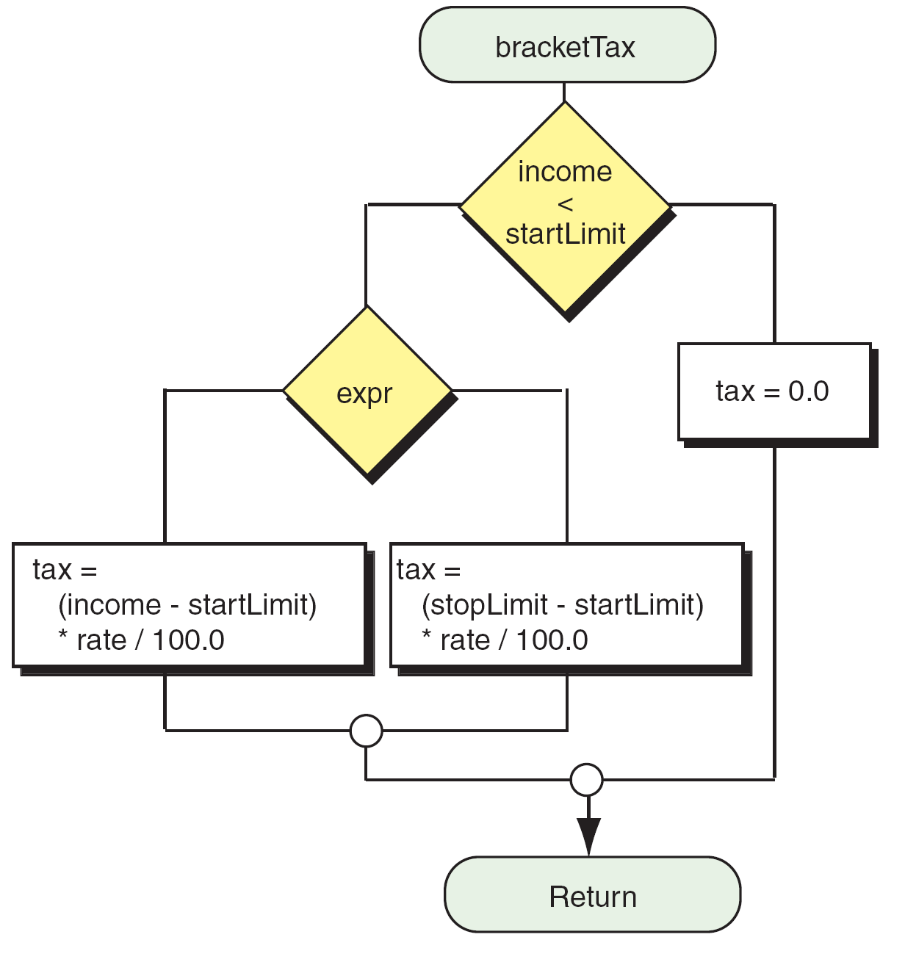
FIGURE 5-18 Design for Program 5-5 (Part III)

Slide 31
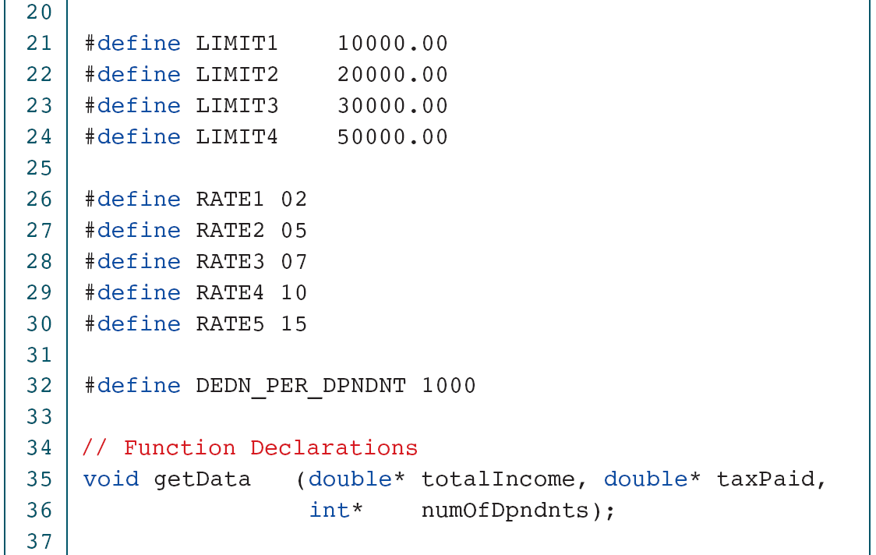
PROGRAM 5-5
Calculate Taxes

Slide 32
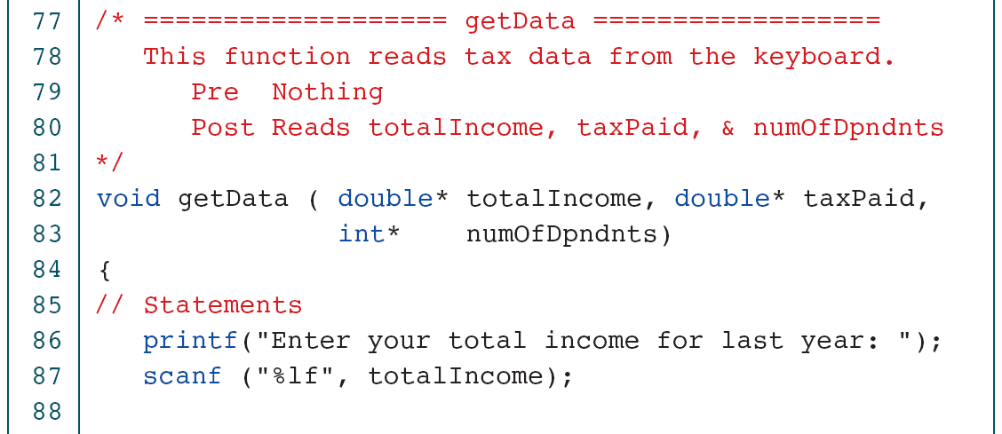

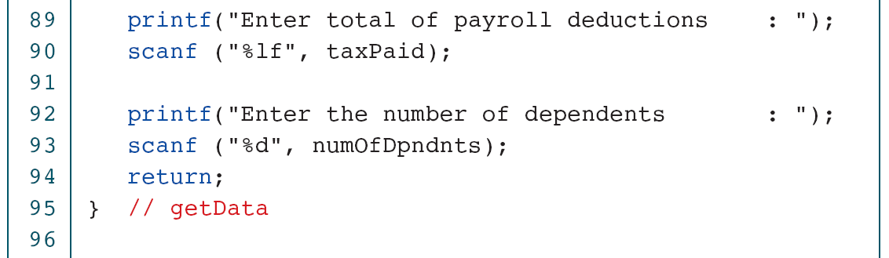

Slide 33
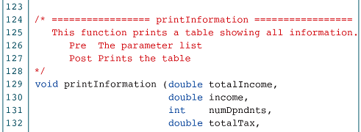

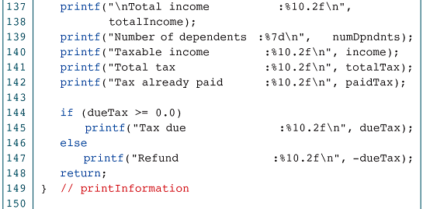
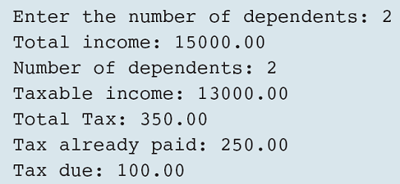

Slide 34
5-3 Multiway Selection
In addition to two-way selection, most programming languages provide another selection concept known as multiway selection. Multiway selection chooses among several alternatives. C has two different ways to implement multiway selection: the switch statement and else-if construct.
Topics discussed in this section:
The switch Statement
The else-if

Slide 35
FIGURE 5-19 switch Decision Logic

Slide 36
FIGURE 5-20 switch Statement Syntax

Slide 37
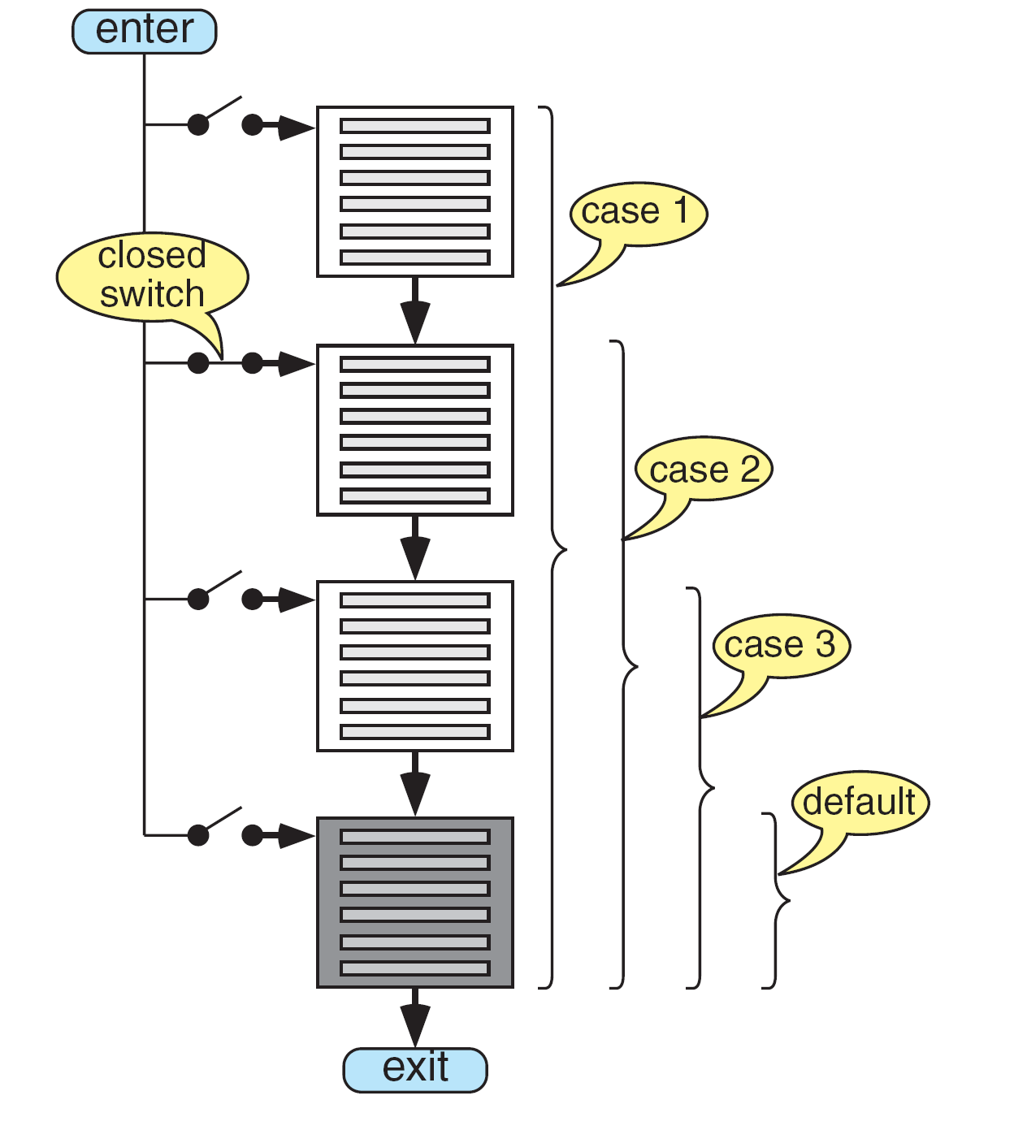
FIGURE 5-21 switch Flow

Slide 38
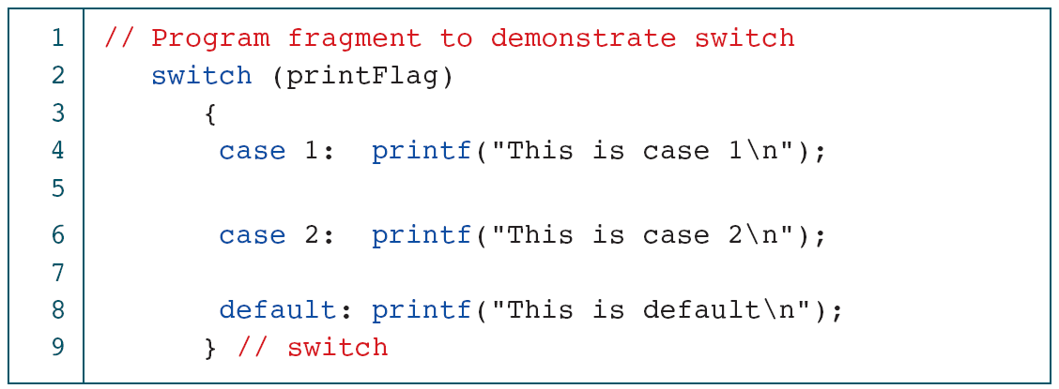
PROGRAM 5-6
Demonstrate the switch Statement

Slide 39
FIGURE 5-22 switch Results

Slide 40
FIGURE 5-23 A switch with break Statements

Slide 41
PROGRAM 5-7
Multivalued case Statements

Slide 42
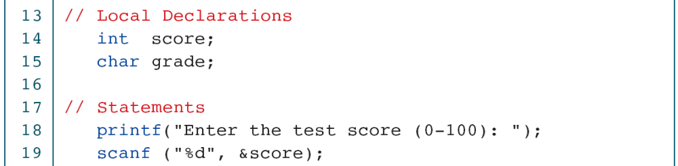
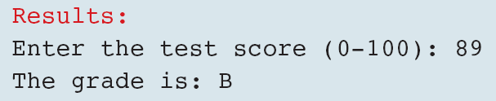
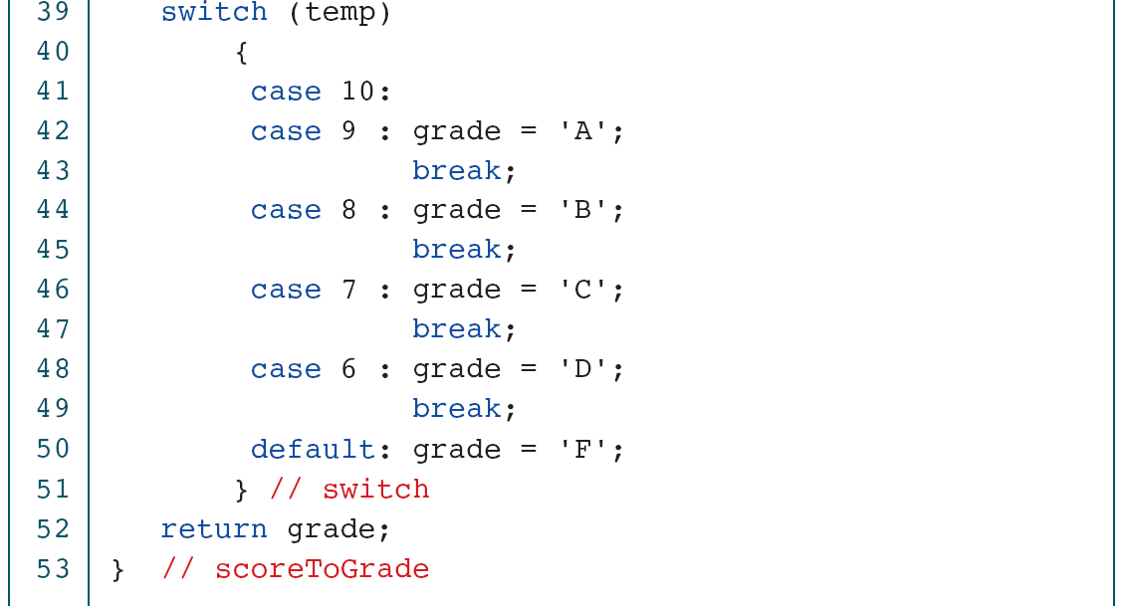
PROGRAM 5-8
Student Grading

Slide 43
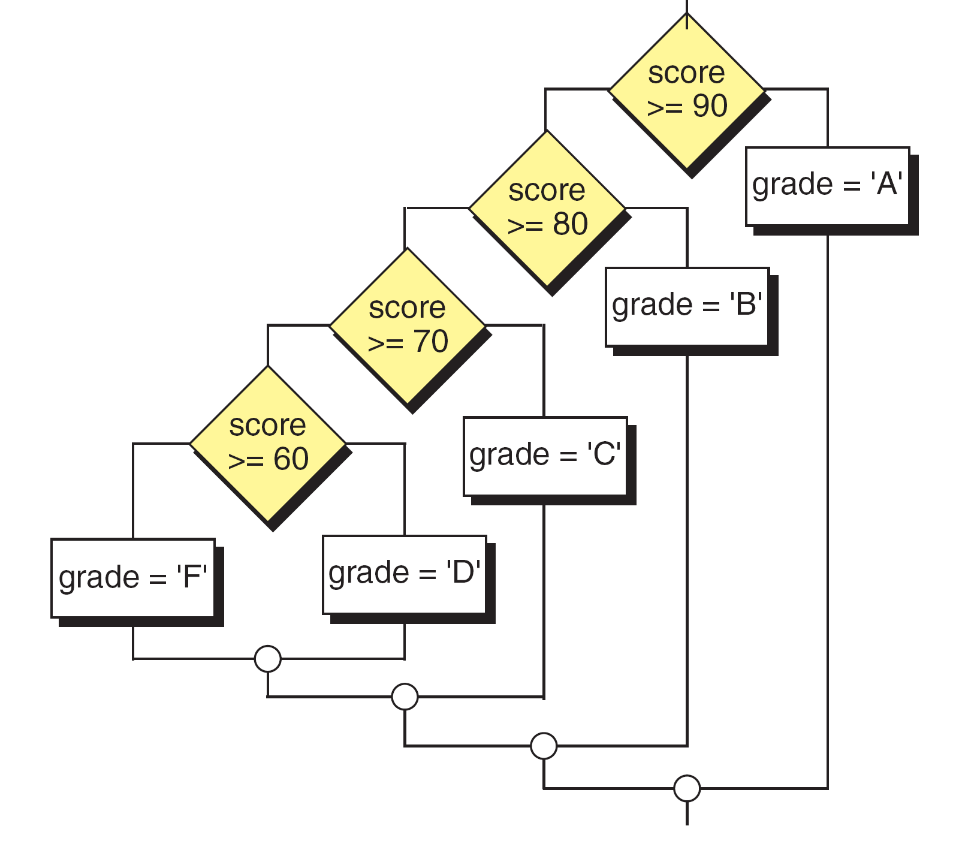
FIGURE 5-24 The else-if Logic Design for Program 5-9

Slide 44
Note
The else-if is an artificial C construct that is only used when
1. The selection variable is not an integral, and
2. The same variable is being tested in the expressions.

Slide 45

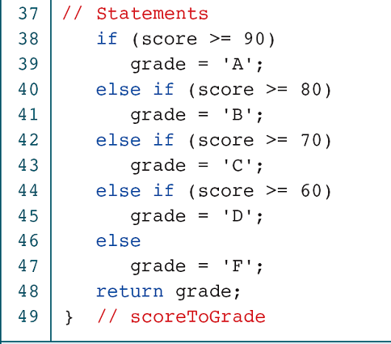
PROGRAM 5-9
Convert Score to Grade

Slide 46
5-4 More Standard Functions
One of the assets of the C language is its rich set of standard functions that make programming much easier. For example, C99 has two parallel but separate header files for manipulating characters: ctype.h and wctype.h.
Topics discussed in this section:
Standard Characters Functions
A Classification Program
Handling Major Errors

Slide 47
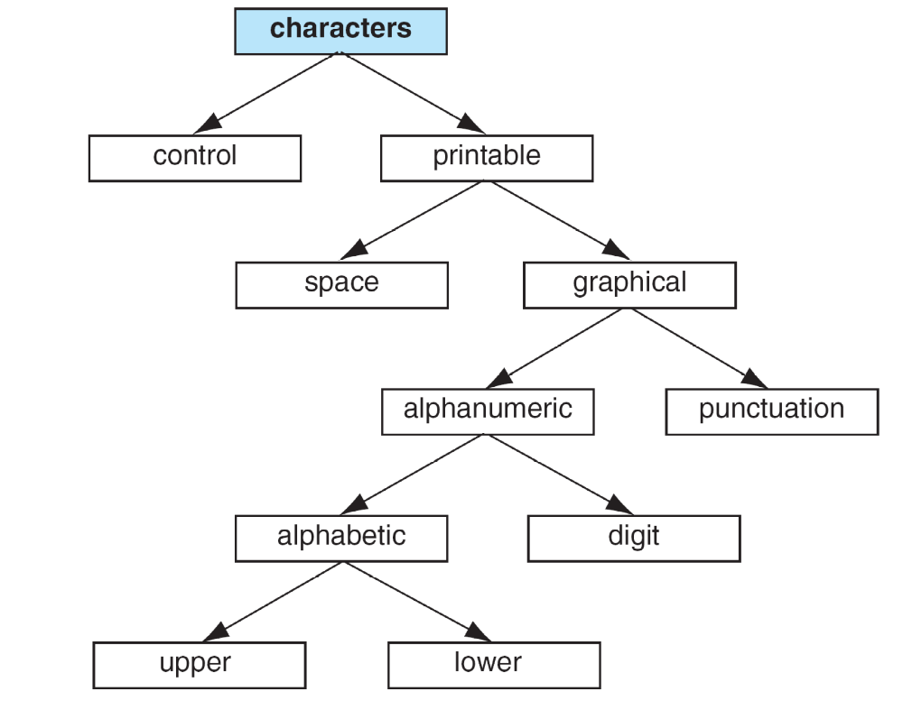
FIGURE 5-25 Classifications of the Character Type

Slide 48
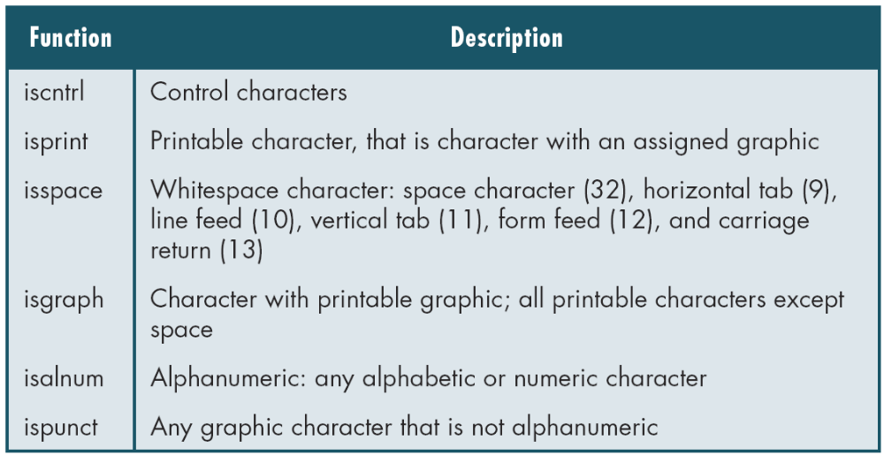
continued
Table 5-6
Classifying Functions

Slide 49
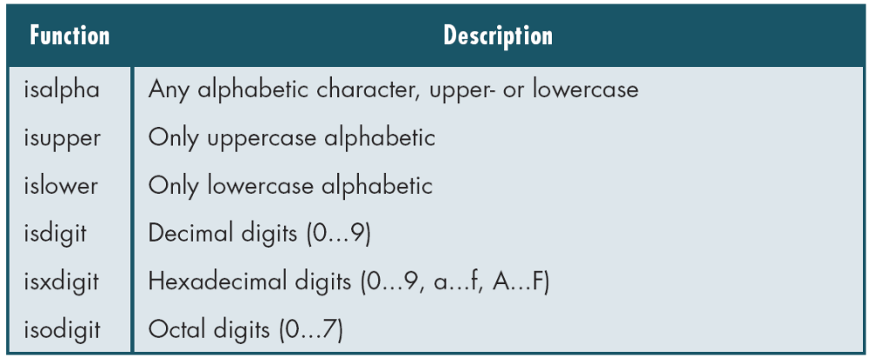
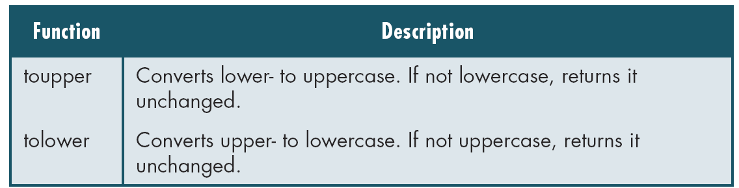
Table 5-6
Classifying Functions (continued)
Table 5-7
Conversion Functions

Slide 50
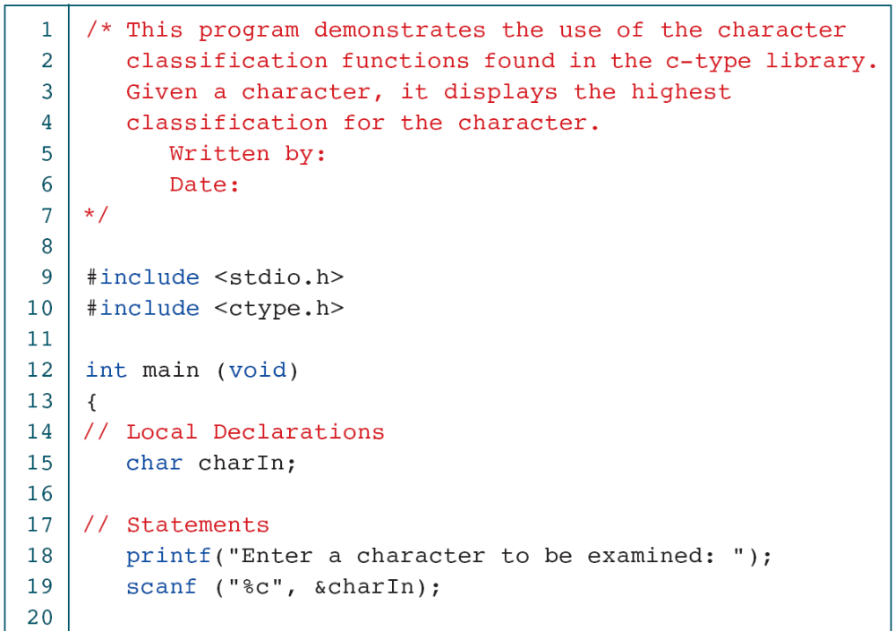
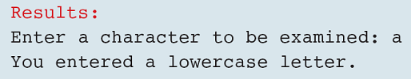
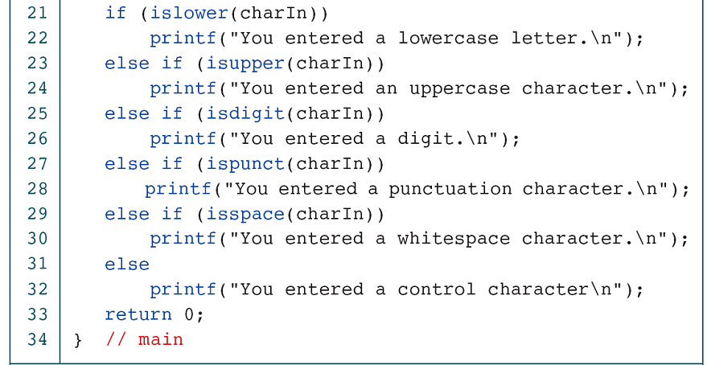
PROGRAM 5-10
Demonstrate Classification Functions

